Slide 1
NextHikes IT Solutions
Exploratory Data Analysis
of Large-Scale Industry Performance Dataset
Univariate • Bivariate • Multivariate Statistical Techniques
15,000 Records
12 Variables
0 Missing Values
0 Duplicates
Presented by: [SWATI MAURYA]
Submission: 5th June, 2026 | NextHikes IT Solutions

Slide 2
AGENDA
01
Dataset Overview
Shape, data types, missing values, duplicates
02
Univariate Analysis
Summary statistics — Mean, Median, Std, Min, Max per variable
03
Skewness & Kurtosis
Actual computed values with distribution interpretation
04
Outlier Detection
IQR & Z-score methods — results from actual data
05
Correlation Analysis
Pearson correlation matrix — bivariate relationships
06
Business Insights
Avg revenue, profit margin & market rating by industry/country/region
07
Key Findings & Conclusion
10 key takeaways and strategic implications

Slide 3
Dataset Overview
15,000
12
0
0
Total Records
Total Columns
Missing Values
Duplicate Records
All 12 Columns
Data Type Summary
id
Integer
Unique identifier
Numerical (6 columns)
company_name
Text
Company name
employee_count, annual_revenue_million,
profit_margin_percent, founded_year,
customer_count, market_rating
industry
Category
5 types
country
Category
4 countries
Categorical (4 columns)
employee_count
Numeric
100 – 5,099
annual_revenue_million
Numeric
50.16 – 1,049.96
industry, country, region, company_name
profit_margin_percent
Numeric
5.00 – 45.00
founded_year
Numeric
1990 – 2019
Date (1 column)
customer_count
Numeric
500 – 100,495
created_date
market_rating
Numeric
0.0 – 5.0
created_date
Date
Record timestamp
ID (1 column)
region
Category
3 regions
id (unique identifier)

Slide 4
Univariate Analysis — Summary Statistics
Computed from actual dataset (15,000 rows) • All values editable in PowerPoint
Variable
Mean
Median
Std Dev
Min
Max
Range
employee_count
2,606.86
2,587.00
1,430.56
100
5,099
4,999
annual_revenue_million
549.73
543.92
288.24
50.16
1,049.96
999.80
profit_margin_percent
25.01
24.91
11.53
5.00
45.00
40.00
founded_year
2,004.37
2,004.00
8.61
1990
2019
29
customer_count
50,449.25
50,726.50
28,744.64
500
100,495
99,995
market_rating
2.51
2.50
1.45
0.00
5.00
5.00
Note: Mean ≈ Median for all variables → Symmetric distributions | No extreme skew observed

Slide 5
Skewness & Kurtosis — Actual Computed Values
📊 Skewness Values
📉 Kurtosis Values
employee_count
0.0023
≈ 0
employee_count
−1.1877
Platy
annual_revenue_million
0.0273
≈ 0
annual_revenue_million
−1.1870
Platy
profit_margin_percent
0.0025
≈ 0
profit_margin_percent
−1.2025
Platy
founded_year
0.0206
≈ 0
founded_year
−1.1896
Platy
customer_count
−0.0048
≈ 0
customer_count
−1.1947
Platy
market_rating
−0.0200
≈ 0
market_rating
−1.2057
Platy
✓ All values close to zero → Symmetric distributions
✓ All negative → Platykurtic (flatter = fewer extreme values)

Slide 6
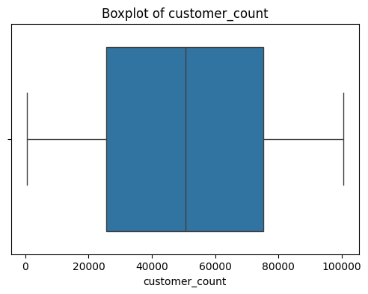
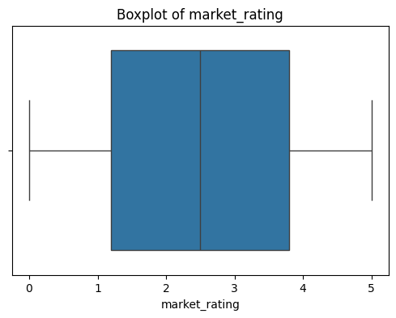
Outlier Detection — IQR & Z-Score Methods
Methods Applied
IQR Results (Actual Values)
IQR Method
employee_count
Q1=1,379 | Q3=3,839 | IQR=2,460
0
Outlier if < Q1−1.5×IQR or > Q3+1.5×IQR
Z-Score
annual_revenue_million
Q1=299.92 | Q3=797.57 | IQR=497.66
0
Outlier if |Z| > 3 (beyond 3 std deviations)
profit_margin_percent
Q1=15.05 | Q3=35.10 | IQR=20.05
0
Boxplot
Visual detection beyond whiskers
customer_count
Q1=25,676 | Q3=75,271 | IQR=49,595
0
RESULT: 0 Outliers in all numerical columns (IQR Method) • 0 Outliers (Z-Score Method)
No significant outliers detected — Data is clean and complete.
Boxplot Graphs
t

Slide 7
Correlation Analysis — Pearson Correlation Values
Pearson correlation computed from actual dataset. All values extremely close to zero.
Variable 1
Variable 2
Pearson r
Interpretation
employee_count
annual_revenue_million
−0.002
Negligible
annual_revenue_million
profit_margin_percent
−0.003
Negligible
profit_margin_percent
market_rating
−0.006
Negligible
customer_count
annual_revenue_million
−0.003
Negligible
employee_count
customer_count
−0.012
Negligible
founded_year
annual_revenue_million
−0.012
Negligible
All correlations are extremely weak and close to zero.
Variables are statistically independent — no multicollinearity issues.

Slide 8
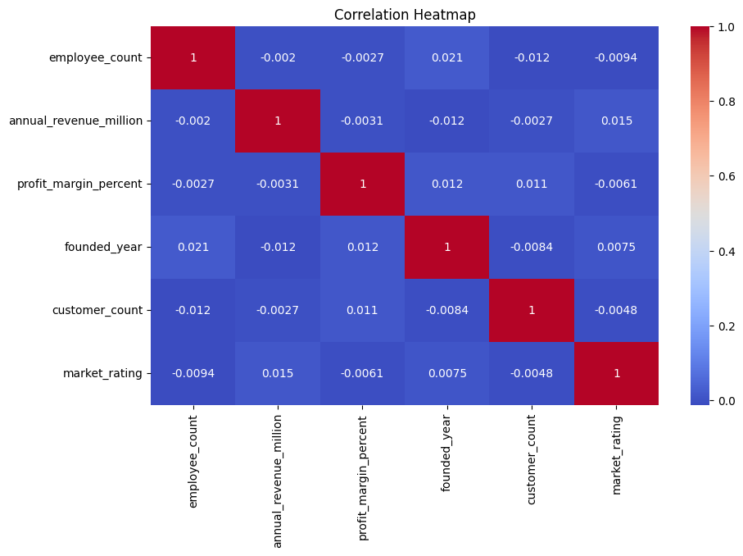
Correlation Matrix Heatmap — Full 6×6 Grid
emp_count
revenue_M
profit_%
fnd_year
cust_cnt
mkt_rating
Color intensity reflects correlation strength. All near zero = no significant relationships.
emp_count
1.0000
-0.0020
-0.0027
0.0212
-0.0124
-0.0094
revenue_M
-0.0020
1.0000
-0.0031
-0.0118
-0.0027
0.0146
profit_%
-0.0027
-0.0031
1.0000
0.0124
0.0113
-0.0061
fnd_year
0.0212
-0.0118
0.0124
1.0000
-0.0084
0.0075
cust_cnt
-0.0124
-0.0027
0.0113
-0.0084
1.0000
-0.0048
mkt_rating
-0.0094
0.0146
-0.0061
0.0075
-0.0048
1.0000
[ INSERT SEABORN HEATMAP IMAGE HERE ] — plt.figure() + sns.heatmap(df.corr(), annot=True)

Slide 9
Industry & Country Distribution
Industry Distribution
Country Distribution
Finance
3,000 (20%)
India
3,750 (25%)
Technology
3,000 (20%)
Germany
3,750 (25%)
Retail
3,000 (20%)
Canada
3,750 (25%)
Manufacturing
3,000 (20%)
USA
3,750 (25%)
Healthcare
3,000 (20%)
✓ Perfectly balanced — 3,000 companies per industry
✓ Perfectly balanced — 3,750 companies per country
Bar / Pie Charts
[ INSERT: Industry bar chart (left) + Country bar/pie chart (right) ]

Slide 10
Business Insights — Avg Revenue, Profit, Rating
Avg Revenue (M) by Industry
Avg Profit Margin % by Industry
Avg Market Rating by Industry
Retail
$556.61
Finance
25.30%
Retail
★ 2.55
Finance
$552.82
Retail
25.09%
Healthcare
★ 2.52
Technology
$550.20
Technology
25.03%
Finance
★ 2.51
Manufacturing
$545.58
Healthcare
24.88%
Technology
★ 2.50
Healthcare
$543.46
Manufacturing
24.76%
Manufacturing
★ 2.49
Avg Revenue by Country
Avg Revenue by Region
USA
India
Canada
Germany
Asia
N. America
Europe
$552.91M
$551.87M
$548.38M
$545.78M
$551.87M
$550.64M
$545.78M

Slide 11
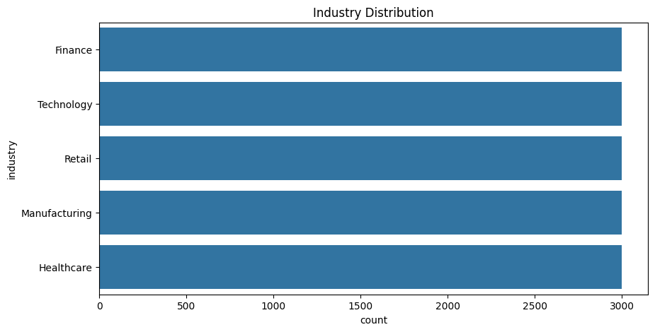
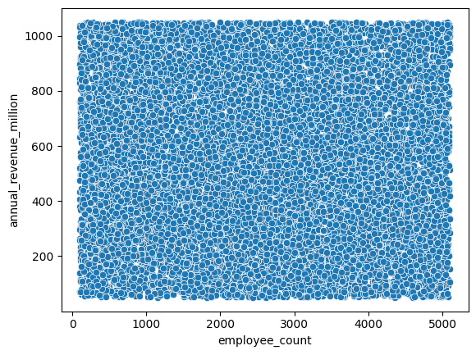
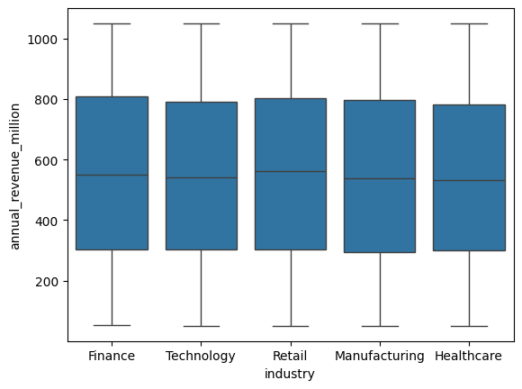
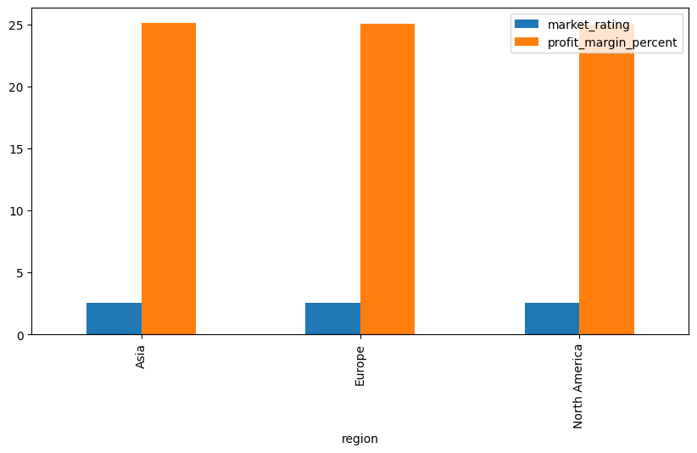
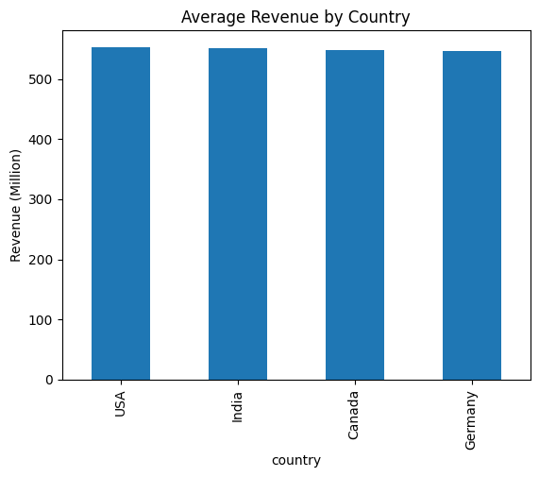
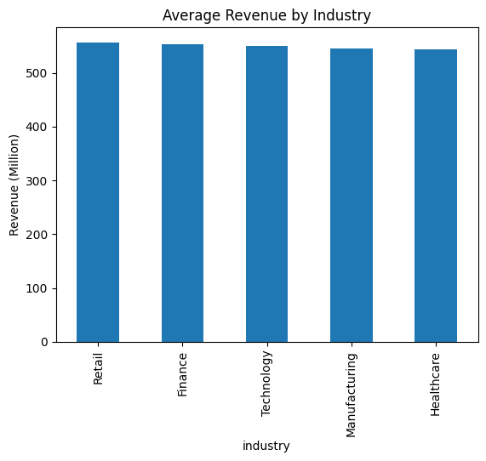
Graphs
Avg Revenue by Industry
Avg Profit Margin by Industry
Avg Market Rating by Industry
[ INSERT GRAPH ]
Bar chart: sns.barplot(x='industry', y='annual_revenue_million')
[ INSERT GRAPH ]
Bar chart: sns.barplot(x='industry', y='profit_margin_percent')
[ INSERT GRAPH ]
Bar chart: sns.barplot(x='industry', y='market_rating')
Avg Revenue by Country
Avg Revenue by Region
Scatter: Employee Count vs Revenue
[ INSERT GRAPH ]
Bar chart: sns.barplot(x='country', y='annual_revenue_million')
[ INSERT GRAPH ]
Bar chart: sns.barplot(x='region', y='annual_revenue_million')
[ INSERT GRAPH ]
Scatter: sns.scatterplot(x='employee_count', y='annual_revenue_million')

Slide 12
KEY FINDINGS & CONCLUSION
Dataset contains 15,000 records and 12 variables with 0 missing values and 0 duplicates.
No missing values, duplicate records, or outliers were detected via IQR and Z-score methods.
01
02
All numerical variables show approximately symmetric distributions (Skewness ≈ 0).
All kurtosis values ≈ −1.19 (Platykurtic) — flatter distributions, fewer extreme observations.
03
04
Correlation analysis revealed negligible relationships among all variable pairs (r ≈ 0).
Retail industry recorded the highest average revenue ($556.61M) and market rating (2.55).
05
06
Finance industry recorded the highest average profit margin (25.30%).
USA generated the highest average revenue ($552.91M) among all countries.
07
08
Business performance remains relatively balanced across all industries and regions.
Dataset is clean and suitable for further business intelligence and predictive analytics.
09
10
Libraries: NumPy • Pandas • Matplotlib • Seaborn

Slide 13
NextHikes IT Solutions
Thank You!
Exploratory Data Analysis — Industry Performance Dataset
Presented by: [SWATI MAURYA]
[mauryaswati1016@gmail.com]
Submission Date: 5th June, 2026 | NextHikes IT Solutions

